Slide 1
Contextual Bandits – A Review
By Ambuj Tewari and Susan A. Murphy
Presented by Zhuoyu Wang

Slide 2
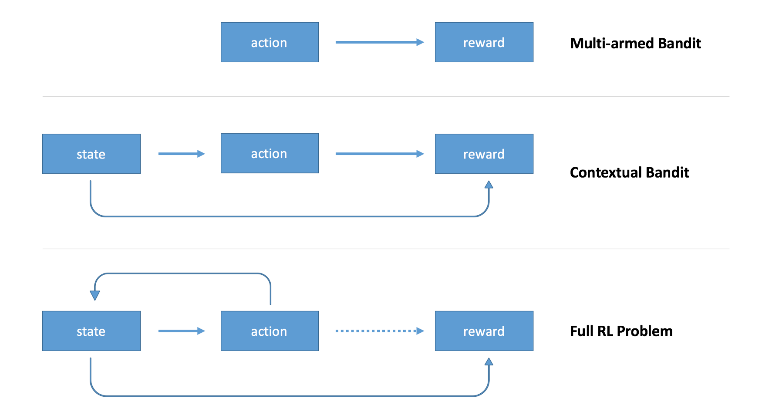
Contextual Bandits
From: https://medium.com/emergent-future/simple-reinforcement-learning-with-tensorflow-part-1-5-contextual-bandits-bff01d1aad9c#.cbuaj1j9e

Slide 3
An Example of Contextual Bandits
In a clinical trial comparing two drugs, some subject information could be available as features.
If so, the clinical trial could be considered as a contextual bandit problem.
The target is to learn how to choose one of the two drugs based on subject features.

Slide 4
Three Types of Contextual Bandits
Stochastic Contextual Bandits
Adversarial Contexts with Stochastic Rewards
Fully Adversarial Contextual Bandits

Slide 5



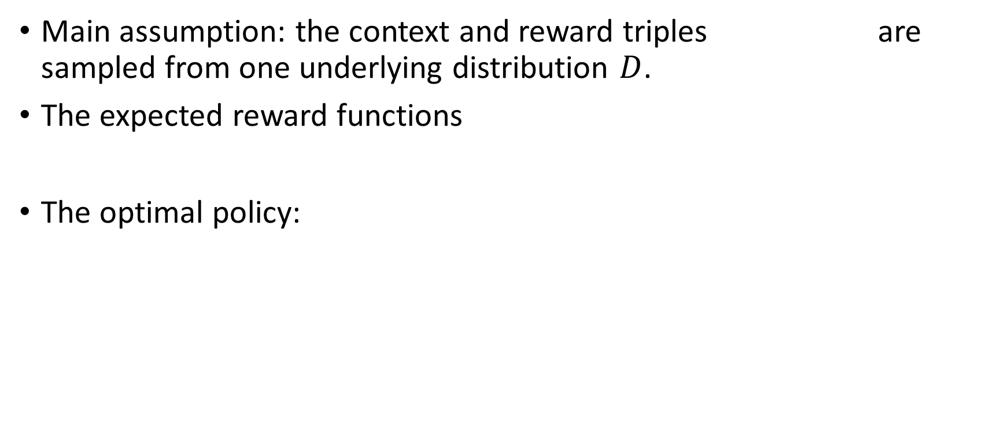
Stochastic Contextual Bandits
Main assumption: the context and reward triples are sampled from one underlying distribution $D$.
The expected reward functions
The optimal policy:

Slide 6




Parametric Estimation of Expected Reward Functions
Assume the underlying distribution D has the linear regression relationship:
The best policy takes the form:
The expected regret of a learning algorithm is
where is the the expected reward function of the optimal policy.

Slide 7
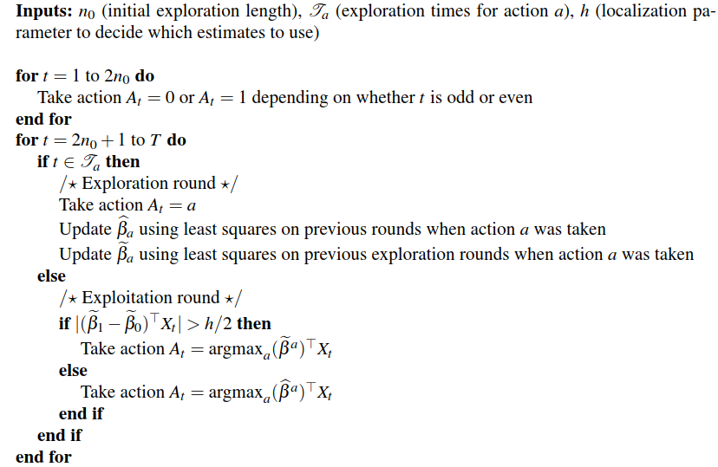

Slide 8


Nonparametric Estimation of Expected Reward Functions
where f_{a} are functions chosen from a non-parametric class of functions.
The best policy becomes:

Slide 9
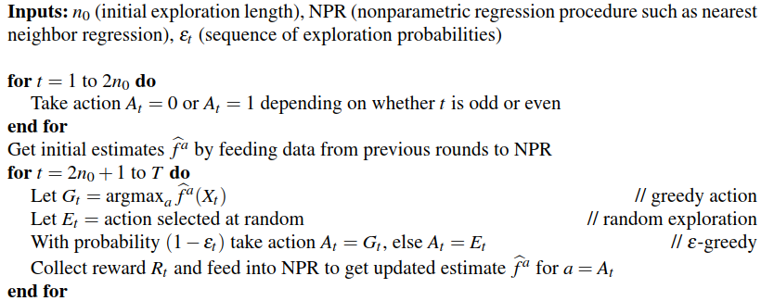

Slide 10



Competing against a Policy Class
Fx a class Π of policies and aim to minimize the expected regret relative to the class Π:
After an exploration round, an unbiased estimator of the value of any policy π:
The policy selected for the next exploitation phase is:

Slide 11
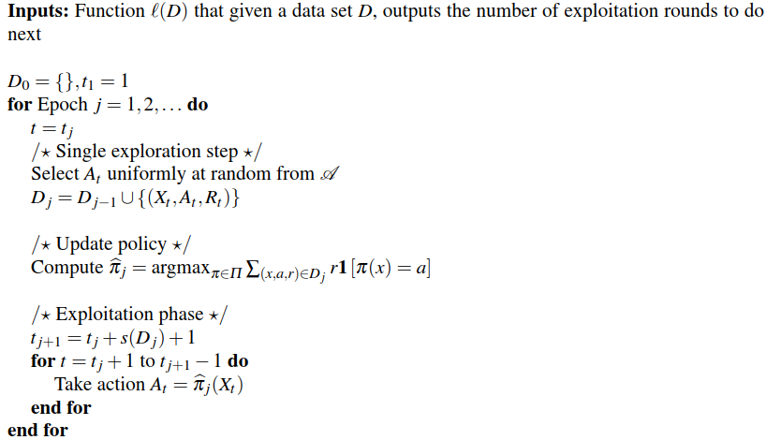

Slide 12
Pros and cons of Stochastic Contextual Bandits
High convergence rate
iid assumption is unrealistic. Example: stress level at different time points.

Slide 13

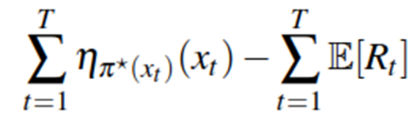
Adversarial Contexts with Stochastic Rewards
The contexts are not iid random variables but from an arbitrary deterministic sequence.
However, the reward given context and action is still stochastic (the two families of distributions over rewards):
The expected regret of an online learning algorithm:

Slide 14

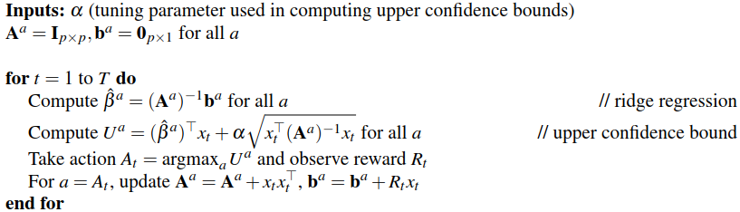
Under linear assumption:

Slide 15
Pros and cons of Adversarial Contexts with Stochastic Rewards
Contexts can have arbitrary relationships one with another.
In reality, how users respond to interventions (e.g., reward distribution given context) can change with time.

Slide 16
Fully Adversarial Contextual Bandits
Competing against Greedy Policies with Changing Reward Distributions
Competing against a Fixed Class of Policies

Slide 17
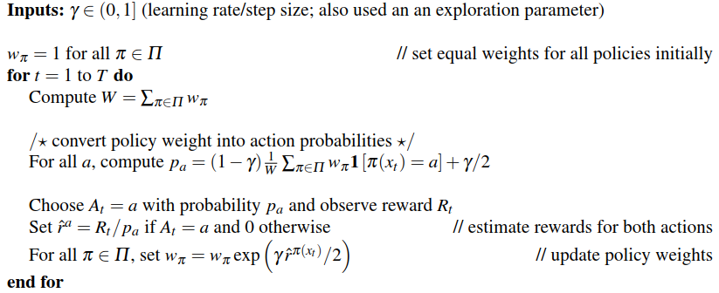

Slide 18
Challenges in Mobile Health Applications
Finding a Good Initial Policy
Interpretability of the Learned Policy
Assessing Usefulness of Contextual Variables
Computational Considerations
Robustness to Failure of Assumptions
Costly to Acquire or Missing Contexts and Rewards

